Slide 3
Linear Correlation
Linear relationships
Curvilinear relationships
Y
Y
X
X
Y
Y
X
X

Slide 4
Linear Correlation
Strong relationships
Weak relationships
Y
Y
X
X
Y
Y
X
X

Slide 5
Linear Correlation
No relationship
Y
X
Y
X

Slide 6
Linear regression
In regression, one variable is considered independent (=predictor) variable (X) and the other the dependent (=outcome) variable Y.

Slide 7
What is “Linear”?
Remember this:
Y=mX+B?
m
B

Slide 8
What’s Slope?
A slope of 2 means that every 1-unit change in X yields a 2-unit change in Y.

Slide 9
Prediction
If you know something about X, this knowledge helps you predict something about Y.

Slide 10
Regression equation…
Expected value of y at a given level of x=

Slide 11
Predicted value for an individual…
y_{i}= α + β*x_{i} + random error_{i}
Follows a normal distribution
Fixed – exactly on the line

Slide 13
Assumptions (or the fine print)
Linear regression assumes that…
1. The relationship between X and Y is linear
2. Y is distributed normally at each value of X
3. The variance of Y at every value of X is the same (homogeneity of variances)
4. The observations are independent

Slide 14
The standard error of Y given X is the average variability around the regression line at any given value of X. It is assumed to be equal at all values of X.
Sy/x
Sy/x
Sy/x
Sy/x
Sy/x
Sy/x

Slide 15
Regression Picture
y_{i}
C
A
B
y
B
A
C
y_{i}
*Least squares estimation gave us the line (β) that minimized C²
x
R²=SSreg/SStotal
A² B² C²
SS_{total}
Total squared distance of observations from naïve mean of y
Total variation
SS_{reg}
Distance from regression line to naïve mean of y
Variability due to x (regression)
SS_{residual}
Variance around the regression line
Additional variability not explained by x—what least squares method aims to minimize

Slide 16
Multiple Linear Regression
More than one predictor…
E(y)= α + β₁*X + β₂ *W + β₃ *Z…
Each regression coefficient is the amount of change in the outcome variable that would be expected per one-unit change of the predictor, if all other variables in the model were held constant.

Slide 17
Residual Analysis for Linearity
Y
Y
x
x
residuals
x
x
residuals
Not Linear
✓
Linear

Slide 18
Residual Analysis for Homoscedasticity
Y
Y
x
x
residuals
x
x
residuals
✓
Non-constant variance
Constant variance

Slide 19
Residual Analysis for Independence
Not Independent
✓
Independent
residuals
X
residuals
X
residuals
X

Slide 20
Fitting of Models – Known Issues
Under fitting

Slide 21
Fitting of Models – Known Issues
Overfitting

Slide 22
Other types of multivariate regression
Multiple linear regression is for normally distributed outcomes
Logistic regression is for binary outcomes

Slide 23
Linear Regression Algorithm in Nut Shell
Outcome / Response / Target Variable should be numerical data ( either continuous or discrete)
Validate assumptions –
Multi collinearity - Variable inflation Factor ( VIF) > 5 then the input variable is likely to be correlated with other variable
Construct Correlation plot to check variables which are correlated. Correlation > 0.7 or < - 0.7 suggests strong correlation
Construct Model –
Create model on training data. ( split your data in Train & Test data)
Check fitted residuals plot – if randomly spread then Y is linearly correlated with all your input variables
Check for R square adjusted value – Larger the R sq adj. value better is the behavior of Y explained by Xs
Statistical significance of Xs - Check for individual p values of Xs. If pvalue (Xn) > 0.05 then does not impact Y and can be removed.
Run stepAIC to auto eliminate statistical insignificant variables
Interpret change in variable by one unit on the Output Variable
Check Accuracy on Test data –
Predict values of unseen test data
Measure Root Mean Square Error of the model
Feature Transformation –
Feature normalization – take log transformation of all your variables ( Y & Xs)
Check performance on Test data
Select model with relatively low RMSE

Slide 24
Common multivariate regression models.
Outcome (dependent variable) | Example outcome variable | Appropriate multivariate regression model | Example equation | What do the coefficients give you?
Continuous | Blood pressure | Linear regression | blood pressure (mmHg) = α + βsalt*salt consumption (tsp/day) + βage*age (years) + βsmoker*ever smoker (yes=1/no=0) | slopes—tells you how much the outcome variable increases for every 1-unit increase in each predictor.
Binary | High blood pressure (yes/no) | Logistic regression | ln (odds of high blood pressure) = α + βsalt*salt consumption (tsp/day) + βage*age (years) + βsmoker*ever smoker (yes=1/no=0) | odds ratios—tells you how much the odds of the outcome increase for every 1-unit increase in each predictor.

Slide 25
Machine Learning
2. LOGISTIC REGRESSION

Slide 26
Categorical Response Variables
Examples:
Whether or not a person smokes
Binary Response
Success of a medical treatment
Opinion poll responses
Ordinal Response

Slide 27
Example: Height predicts Gender
Y = Gender (0=Male 1=Female)
X = Height (inches)
Try an ordinary linear regression
> regmodel=lm(Gender~Hgt,data=Pulse)
> summary(regmodel)
Coefficients:
Estimate Std. Error t value Pr(>|t|)
(Intercept) 7.343647 0.397563 18.47 <2e-16 ***
Hgt -0.100658 0.005817 -17.30 <2e-16 ***
Notes:
Pulse.csv datafile

Slide 28
Notes:
> plot(Pulse$Gender~Pulse$Hgt)
> abline(regmodel)

Slide 29
π = Proportion of “Success”
In ordinary regression the model predicts the mean Y for any combination of predictors.
What’s the “mean” of a 0/1 indicator variable?
Goal of logistic regression: Predict the “true” proportion of success, π, at any value of the predictor.

Slide 30
Binary Logistic Regression Model
Y = Binary response
X = Quantitative predictor
π = proportion of 1’s (yes,success) at any X
Equivalent forms of the logistic regression model:
Logit form
Probability form
N.B.: This is natural log (aka “ln”)

Slide 31
Binary Logistic Regression via R
> logitmodel=glm(Gender~Hgt,family=binomial, data=Pulse)
> summary(logitmodel)
Call:
glm(formula = Gender ~ Hgt, family = binomial)
Deviance Residuals:
Min 1Q Median 3Q Max
-2.77443 -0.34870 -0.05375 0.32973 2.37928
Coefficients:
Estimate Std. Error z value Pr(>|z|)
(Intercept) 64.1416 8.3694 7.664 1.81e-14 ***
Hgt -0.9424 0.1227 -7.680 1.60e-14***
---

Slide 32
Call:
glm(formula = Gender ~ Hgt, family = binomial, data = Pulse)
Coefficients:
Estimate Std. Error z value Pr(>|z|)
(Intercept) 64.1416 8.3694 7.664 1.81e-14 ***
Hgt -0.9424 0.1227 -7.680 1.60e-14***
---
proportion of females at that Hgt

Slide 33
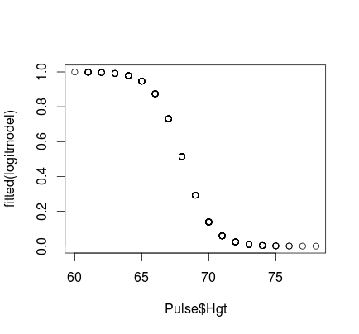
> plot(fitted(logitmodel)~Pulse$Hgt)

Slide 34
Odds
Definition:
is the odds of Yes.

Slide 35
Odds
Logit form of the model:
⇒
The logistic model assumes a linear relationship between the predictors and log(odds).

Slide 36
Interpreting “Slope” using Odds Ratio
⇒
When we increase X by 1, the ratio of the new odds to the old odds is
i.e. odds are multiplied by

Slide 37
3. Intro Decision Trees

Slide 38
Decision Trees
Problem: decide whether to wait for a table at a restaurant, based on the following attributes:
Alternate: is there an alternative restaurant nearby?
Bar: is there a comfortable bar area to wait in?
Fri/Sat: is today Friday or Saturday?
Hungry: are we hungry?
Patrons: number of people in the restaurant (None, Some, Full)
Price: price range ($, $$, $$$)
Raining: is it raining outside?
Reservation: have we made a reservation?
Type: kind of restaurant (French, Italian, Thai, Burger)
WaitEstimate: estimated waiting time (0-10, 10-30, 30-60, >60)

Slide 39
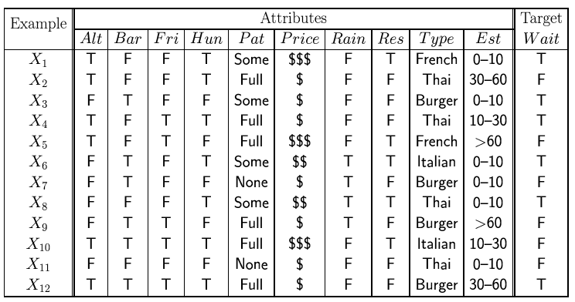
Attribute-based representations
Examples described by attribute values (Boolean, discrete, continuous)
E.g., situations where I will/won't wait for a table:
Classification of examples is positive (T) or negative (F)
General form for data: a number N of instances, each with attributes (x1,x2,x3,...xd) and target value y.

Slide 40
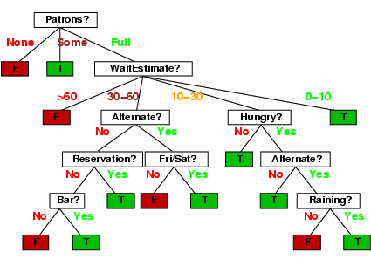
Decision trees
One possible representation for hypotheses
We imagine someone taking a sequence of decisions.
E.g., here is the “true” tree for deciding whether to wait:
Note you can use the same
attribute more than once.

Slide 41
Decision tree learning
If there are so many possible trees, can we actually search this space? (solution: greedy search).
Aim: find a small tree consistent with the training examples
Idea: (recursively) choose "most significant" attribute as root of (sub)tree.

Slide 42
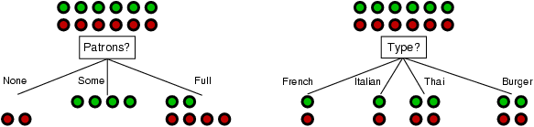
Choosing an attribute
Idea: a good attribute splits the examples into subsets that are (ideally) "all positive" or "all negative"
Patrons or type?
To wait or not to wait is still at 50%.

Slide 43
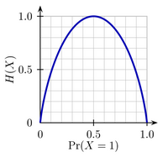
Using information theory
Entropy measures the amount of uncertainty
in a probability distribution:
Consider tossing a biased coin.
If you toss the coin VERY often,
the frequency of heads is, say, p,
and hence the frequency of tails is
1-p. (fair coin p=0.5).
The uncertainty in any actual outcome
is given by the entropy:
Note, the uncertainty is zero if p=0 or 1
and maximal if we have p=0.5.

Slide 44
Using information theory
Imagine we have p examples which are true (positive) and n examples which are false (negative).
Our best estimate of true or false is given by:
Hence the entropy is given by:

Slide 45
Using Information Theory
How much information do we gain if we disclose the value of some attribute?
Answer:
uncertainty before minus uncertainty after

Slide 46
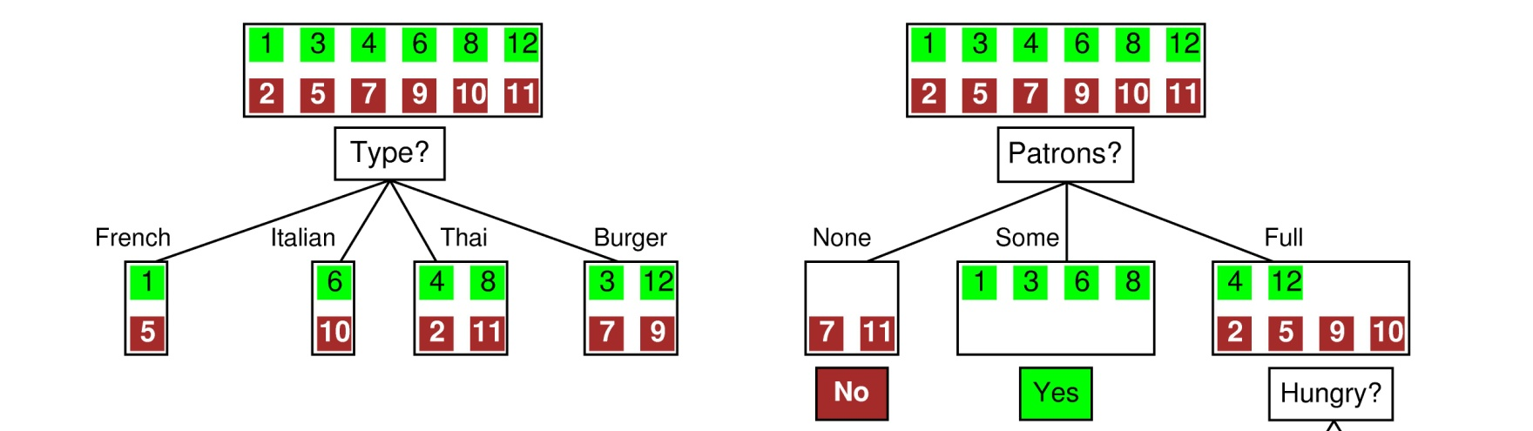
Example
Before: Entropy = - ½ log(1/2) – ½ log(1/2)=log(2) = 1 bit:
There is “1 bit of information to be discovered”.
After: for Type: If we go into branch “French” we have 1 bit, similarly for the others.
French: 1bit
Italian: 1 bit
Thai: 1 bit
Burger: 1bit
After: for Patrons: In branch “None” and “Some” entropy = 0!,
In “Full” entropy = -1/3log(1/3)-2/3log(2/3).
So Patrons gains more information!
On average: 1 bit ! We gained nothing!

Slide 47
Information gain
Information Gain (IG) or reduction in entropy from the attribute test:
Choose the attribute with the largest IG

Slide 48
Information gain
For the training set, p = n = 6, I(6/12, 6/12) = 1 bit
Patrons has the highest IG of all attributes and so is chosen by the DTL algorithm as the root
Is it sensible to have the same attribute on a single branch of the tree (why)?

Slide 49
Continuous Variables
If variables are continuous we can bin them, or..
We can learn a simple classifier on a single dimension
E.g. we can find a decision point which classifies all data to the left of that point in one class and all data to the right in the other
We can also use a small subset of dimensions and train a linear classifier (e.g. logistic regression classifier).

Slide 50
Overfitting and Underfitting
Overfitting:
Given a model space H, a specific model h∈H is said to overfit the training data if there exists some alternative model h’∈H, such that h has smaller error than h’ over the training examples, but h’ has smaller error than h over the entire distribution of instances
Underfitting:
The model is too simple, so that both training and test errors are large

Slide 51
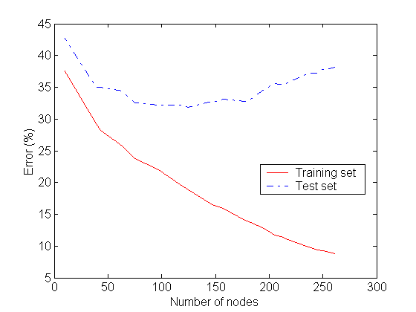
Detecting Overfitting
Overfitting

Slide 52
Overfitting in Decision Tree Learning
Overfitting results in decision trees that are more complex than necessary
Tree growth went too far
Number of instances gets smaller as we build the tree (e.g., several leaves match a single example)
Training error no longer provides a good estimate of how well the tree will perform on previously unseen records

Slide 53
Avoiding Tree Overfitting – Solution 1
Pre-Pruning (Early Stopping Rule)
Stop the algorithm before it becomes a fully-grown tree
Typical stopping conditions for a node:
Stop if all instances belong to the same class
Stop if all the attribute values are the same
More restrictive conditions:
Stop if number of instances is less than some user-specified threshold
Stop if expanding the current node does not improve impurity measures (e.g., GAIN)

Slide 54
Decision Tree Based Classification
Advantages:
Inexpensive to construct
Extremely fast at classifying unknown records
Easy to interpret for small-sized trees
Disadvantages:
Redundancy
Need to retrain with new data

